Slide 1
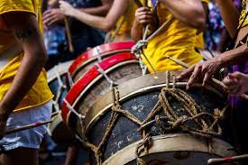
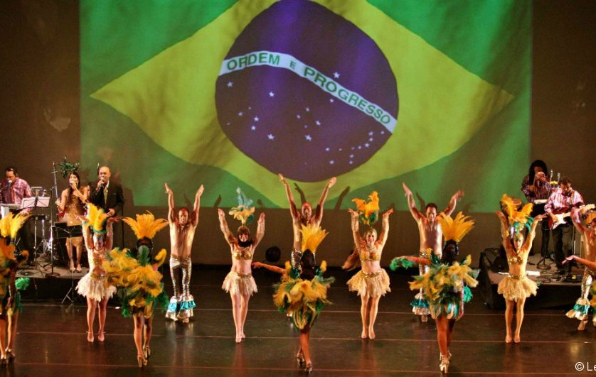
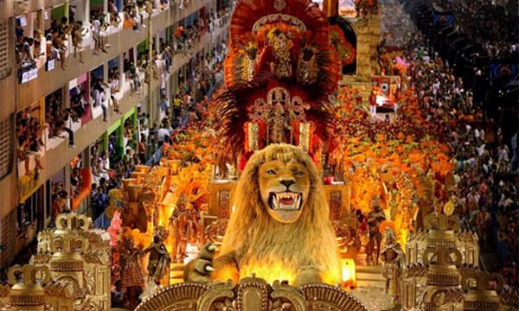
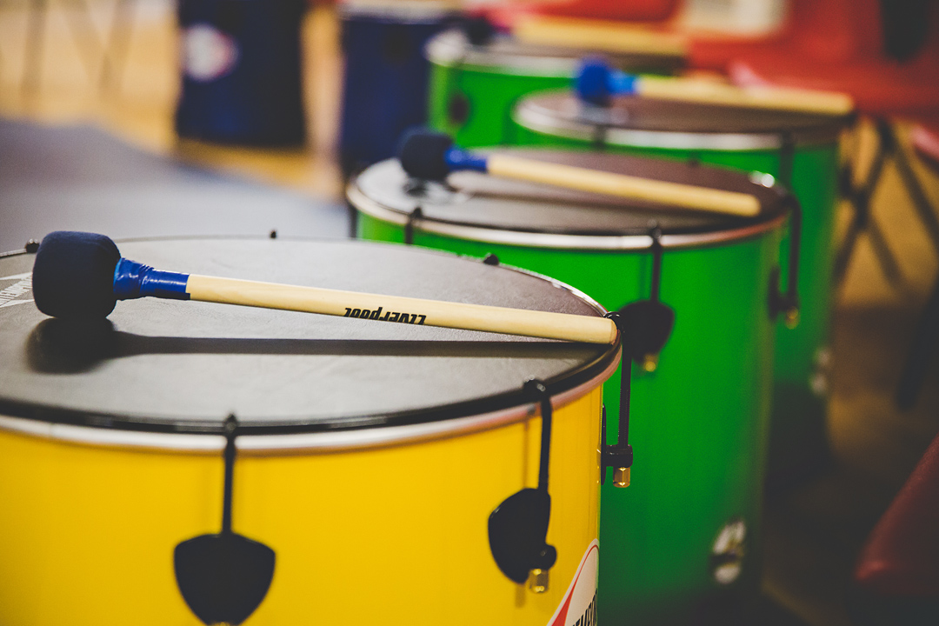
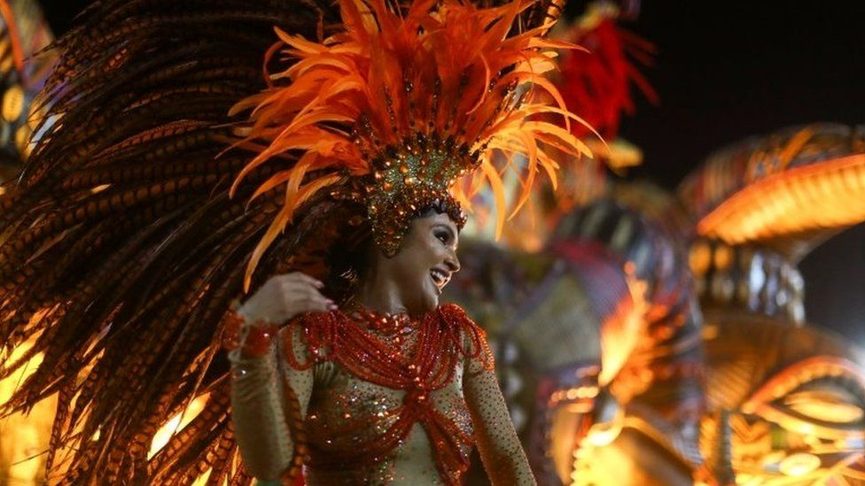
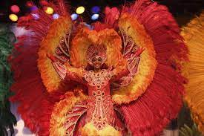
Samba
IGCSE SET WORKS 2024

Slide 2
Samba Context
Samba is an Afro-Brazilian form of clamorous dance music that is associated characteristically with the carnival context.
The samba of Rio de Janeiro developed between the late 1920s and the early 1940s from traditional forms of samba that had been practised in the north-eastern state of Bahia, a region which saw the arrival of the first African slaves brought to Brazil.
In the late nineteenth century, with slavery abolished and with a post-emancipation wave of labour migration, the musical form was brought to Rio de Janeiro.
Here it was practised widely in the morros, the poorer hillside neighbourhoods and the favela (slums).
Early samba is a mix of European-derived dance music combined with African-derived rhythm and musical practices.
In 1928, the first samba school (escola de samba) was formed. Today, many kinds of samba sub-styles exist.
One of the most well-known style is the Carnival samba (samba-eneredo or samba-carnavalesco). It is closely associated with a large percussion section and a strongly syncopated style of playing that gave the music its Afro-Brazilian identity.

Slide 3
Rio Carnival

Slide 4
Instruments

Slide 5
Instruments
The large percussion section in samba is called the bateria.
Cavaquinho and guitars are also used to provide harmonic accompaniment to the vocals; some of the pitched percussion instruments can also contribute to the melody.

Slide 6
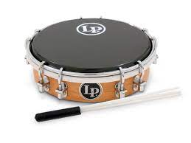
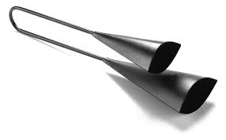
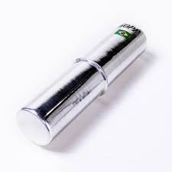
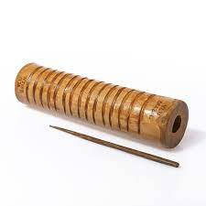
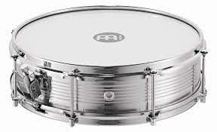
Percussion Instruments
Tamborim – a small round frame drum of Portuguese and African origin without snares or jingles. The drum is made of metal, wood or plastic whilst the head is made of nylon. It is normally tightly tuned to ensure a high, sharp timbre. It is usually played with a small wooden drumstick or with a beater made of nylon strings or threads bound together.
Agogô – a double metal bell attached by a u-shaped piece of metal. Agogôs may be of different sizes and shapes; the bells produce two different pitches. A wooden stick is used to hit the bells to produce a cowbell- like sound or they could be squeezed together to produce a clicking sound.
Ganzá – a cylindrical rattle or shaker made from plastic, metal or hand-woven basket materials. It is filled with beads, metal balls, pebbles or other similar items to create rattling sounds.
Reco-reco – a notched scraper made of bamboo or metal.
Caixa – a snare drum played with two wooden drum sticks. It has metal wires or strings that run across one head to give it a ‘snare drum’ sound.

Slide 7
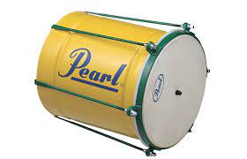
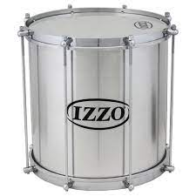
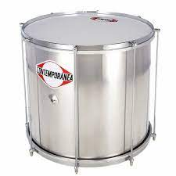
Instruments
Cuíca – a single-headed bucket-shaped friction drum. A long, thin stick pierces through the centre of the drumskin. A unique squeaking sound is made by rubbing the stick between the thumb and forefinger with a damp sponge or piece of leather.
Repinique – a medium-sized, two-headed drum. In samba music, it is a lead and solo instrument as it is tuned to a very high pitch to stand out among the rest of the ensembles. It is played with one wooden stick and one hand.
Surdo – a large bass drum about 60 cm deep. Three surdo drums, of different diameters, are used; they are played with one mallet, with the other hand damping the head.

Slide 8
Demonstrate Musical Instruments

Slide 9
Musical characteristics

Slide 10
Musical and Rhythmic Structure
Samba music is typically in 2/4 metre, comprising catchy eight-bar melodic phrases;
in instrumental sambas these are typically performed either by a guitar, cavaquinho or mandolin.
A key feature of samba is the percussion break known as paradinha (‘little stop’). They can be inserted between the verses and the song refrain.
A song may also end on a paradinha. During these percussion breaks, the bateria stops the main samba groove to play a call and response phrase or to play a different rhythm. In these, the lead repinique plays the calls. Samba songs typically consist of introduction, verse and chorus.
Samba rhythm is characterised by syncopated rhythms and a fast, energetic tempo.

Slide 12
Musical and Rhythmic Structure
The percussion instruments in the bateria combine to produce a dense polyrhythmic texture. In the Rio de Janeiro-style Carnival samba, three surdo drums create a distinctive pattern which propels and drives the music.
The largest and deepest-pitched surdo (the ‘primeira’/first part) provides the pulse or rhythmic reference for the entire bateria.
It plays beat 2 of the duple metre and may also sound pick-up notes to start the music. T
he primeira is answered by a slightly smaller and higher-pitched ‘segunda’/second surdo which sounds beat 1 of the basic 1, 2 rhythm of samba.
A third surdo known as ‘terceira’/third part is played on the smallest and highest-pitched surdo.
The terceira part consists of more complex patterns that provide fills and syncopations, ‘cutting’ across the basic pulse created by the other two surdo parts. Terceira patterns provide the important ‘swing’ feel of the bateria.

Slide 14
Each samba school has its own terceira rhythmic pattern. When there is a rest in the surdo rhythms, the non- mallet hand creates a soft dampened sound by holding the fingertips flat on the drumhead.
The agogô bell typically plays a simple duple metre rhythm. Ex. 5 A typical pattern played by the agogô (Howard 2019)

Slide 17
Performance context

Slide 18
Performance Context
Samba is performed in the pre-Lenten street Carnival celebrations which culminate in the three days preceding Ash Wednesday.
Carnival season typically lasts four or five days. Merry-making, singing and dancing and a parade in which participating groups wear extravagant costumes to mark this celebration.
Sambistas dance through the city streets followed by batteries of deafening percussion.
Samba schools compete for prizes based on their music performance, dance choreography and costumes.
Each school’s performance is centred around a specific theme, typically one that promotes Brazilian identity and revolves around national, historical or political figures and events.
By the mid-1920s, the growing record industry was producing recordings of samba and its music was played on radio stations, increasing its popularity both nationally and abroad.

Slide 19
Socio-political context

Slide 20
Socio-political context
In the early 1920s, as samba developed in the poor hillside neighbourhoods of Rio de Janeiro and was associated with dissenting groups, the music and its erotic dances were considered vulgar and not well looked upon by the local authorities and the elite.
But as Carnival took hold, parading groups of sambistas and samba music began to gain popularity, especially among the rising middle class and abroad due to the rising recording industry and radio. Samba was promoted by the government in the 1930s. In 1934, Carnival was designated as an official national event and samba became a part of the government’s Estado Novo (New State) campaign as a symbol of Brazilian identity.
Registered samba schools flourished with support from public funds and samba’s association with Carnival was validated.
By the 1960s, the samba schools had increased greatly in size.
After the Brazilian capital was moved from Rio de Janeiro to the newly-built city of Brasilia, commercialisation of samba schools set in as Carnival became more competitive as it became an important part of the tourist economy of the city.
Today, the samba schools and samba music have continued to be the nucleus of Carnival and Rio de Janeiro’s principal focus of tourism.

