Slide 1
MODULATION
WHAT IS A MODULATION?
RELATED KEYS
PIVOT CHORD
HOW TO MAKE MODULATION TO THE RELATED KEYS?

Slide 2
Modulation
Modulation describes the process where a piece of music changes from one key to another key. Modulation is a very important part of music composition, as it allows you to move smoothly from the home key to many other keys.
‘Mazurka’ by Tchaikovsky

Slide 3
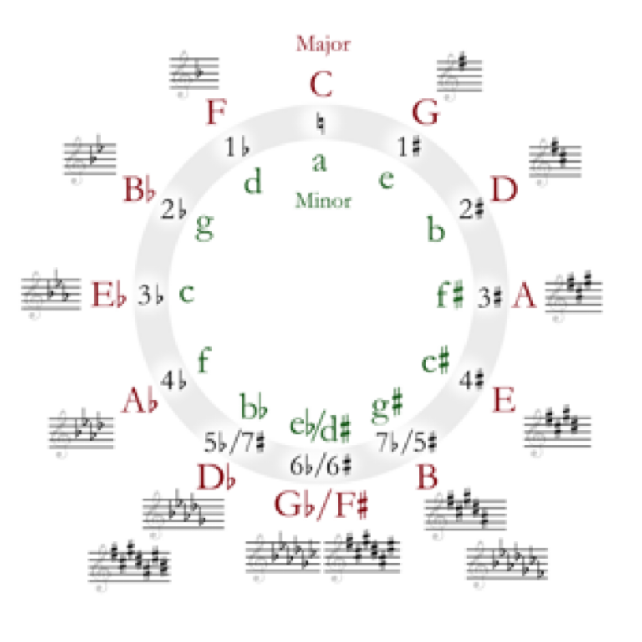
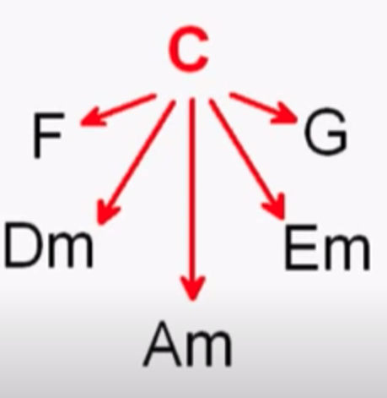
How to find closely related keys?
Closely Related Keys are keys that share many common tones with one another. To find closely related keys, take a look at their chords. Let’s use C Major as an example.
1. The capital letters in red are major.
2. The lower case letters in green are minor.
3. Pick your starting key, for instance, C Major.
4. The closely related keys are either one key to the left or one key to the right. For instance, F major closely related to C Major, as is G major, including their relative minors d minor and e minor.
5. They are considered closely related, because they are only 1 accidental different from each other.

Slide 4
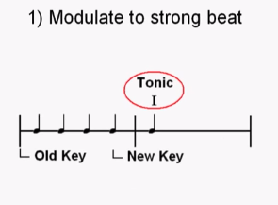
Main rules of Modulations:
Modulation has to end on a strong beat, such as the first beat of the bar

Slide 5
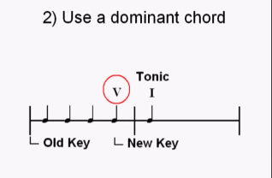

Slide 6
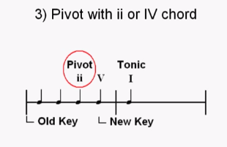
Pivot chord is a chord which is common for both keys.
The advantage of pivot chord modulation is that it enables a smooth change
from one key to another.

Slide 7


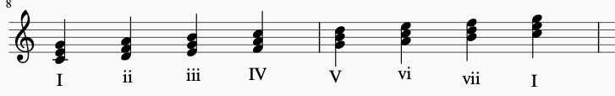

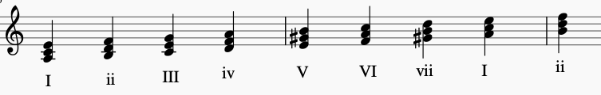
Between C Major and A minor
5 COMMON CHORDS: C,d,F,a,bdim
C major
A minor

Slide 8
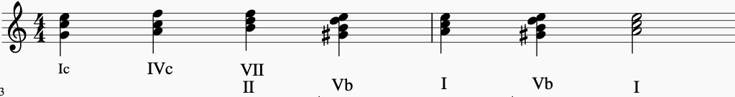
Modulation from C major to A minor
C major
Pivot chord
A minor
Dominant 7 chord
New Tonic

Slide 9
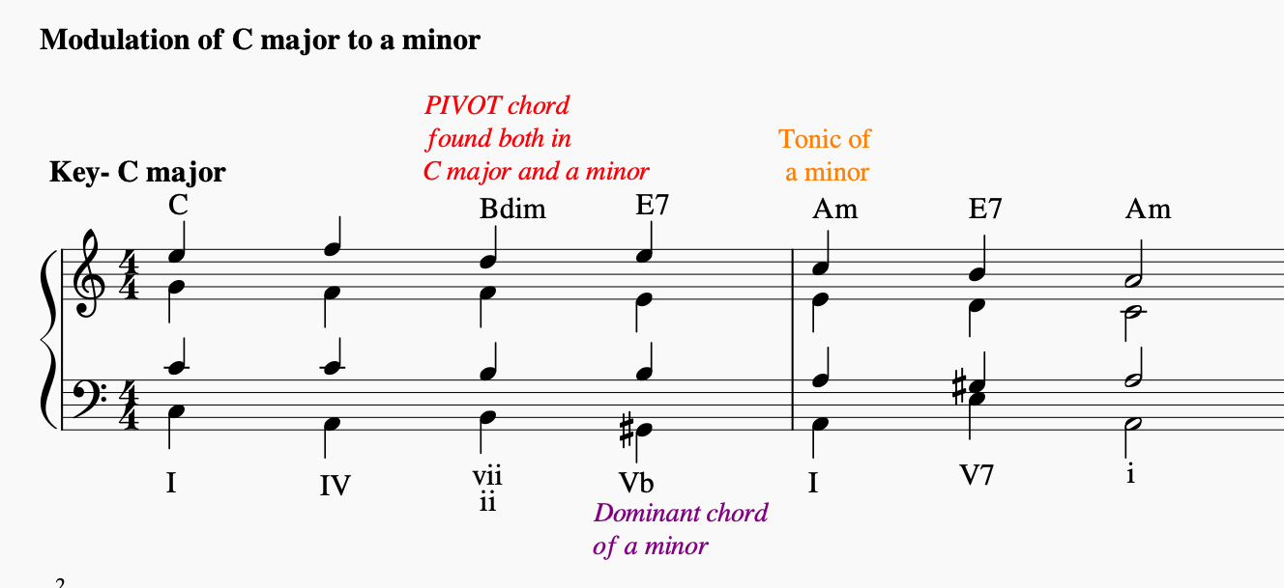

Slide 10



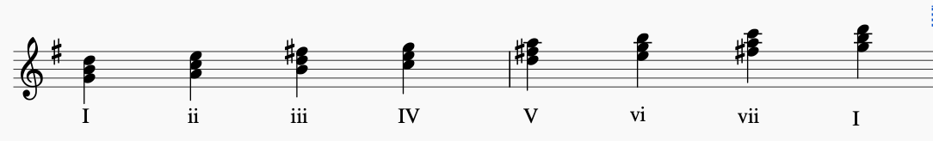
Between C Major and G Major
4 COMMON CHORDS: e,G,a,C chords
C major
G major

Slide 11
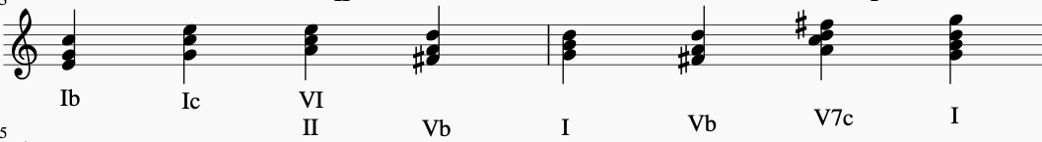
Modulation from C major to G major
C major
Pivot chord
G major
Dominant chord
New Tonic

Slide 12
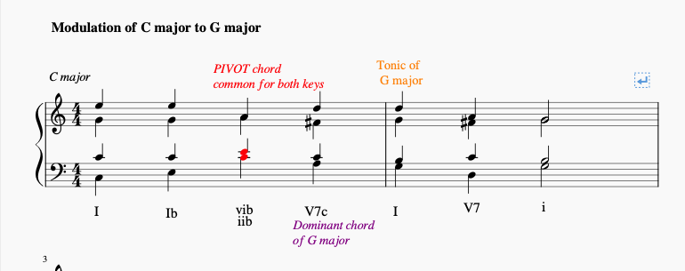

Slide 13

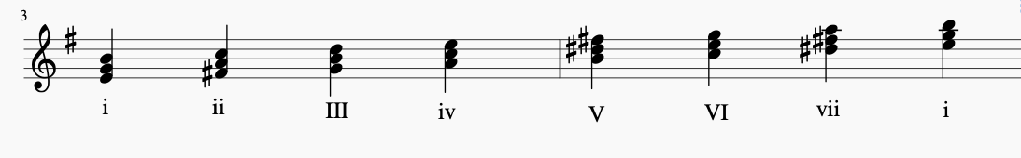
Between C Major and e minor
3 COMMON CHORDS: e, a, C chords
C major
E minor

Slide 14
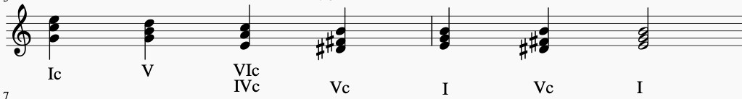
Modulation from C major to E minor
C major
Pivot chord
E minor
Dominant chord
New Tonic

Slide 15
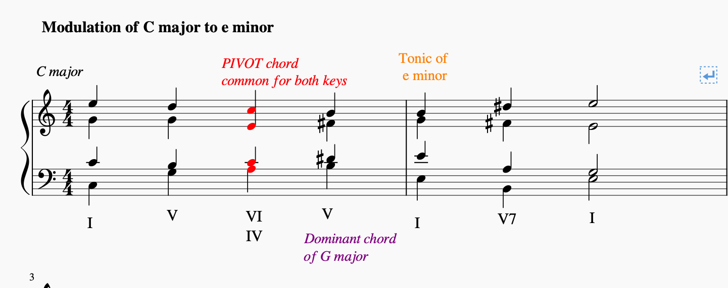

Slide 16


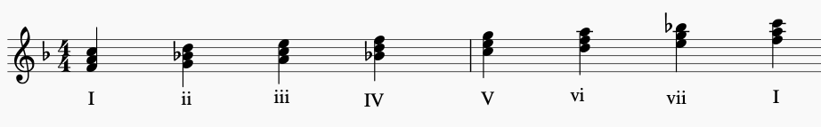
Between C Major and F major
4 COMMON CHORDS: C, d, F, a chords
C major
F major

Slide 17
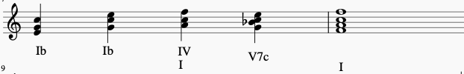
Modulation from C major to F major
C major
Pivot chord
F major
Dominant chord
New Tonic

Slide 18
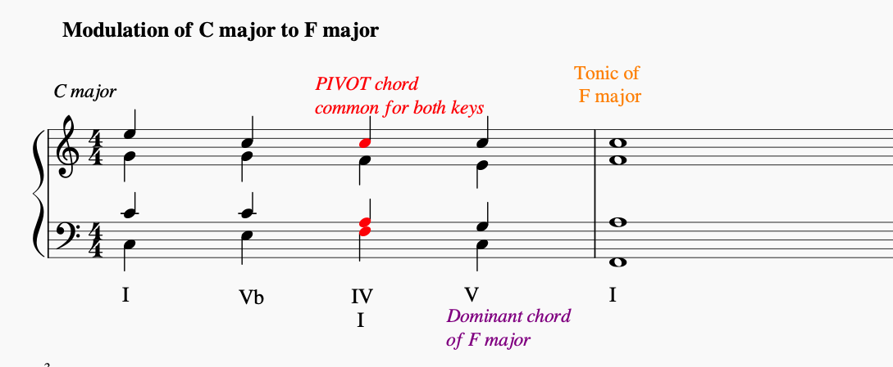

Slide 19
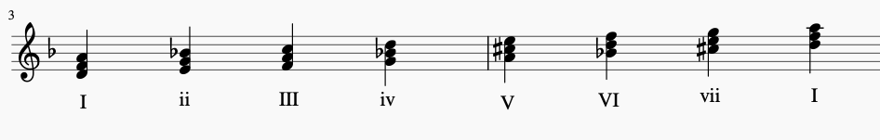
Between C Major and d minor
1 COMMON CHORDS: d chords
C major
D minor

Slide 20

Modulation from C major to d minor
C major
Pivot chord
D minor
Dominant chord
New Tonic

Slide 21
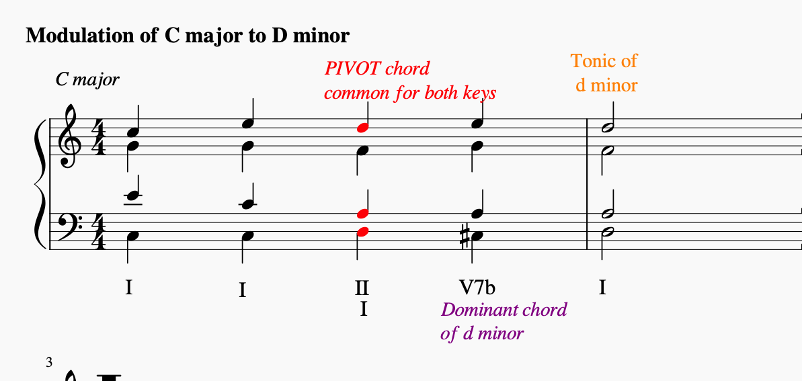

Slide 22
Other keys with common chords
Key | Number of common chords with C major | Common chords
D major | 2 | Em, G
B minor | 2 | Em, G
Bb major | 2 | Dm, F
C minor | 2 | G, Bdim
F minor | 1 | C
Bb minor | 1 | F

Slide 23
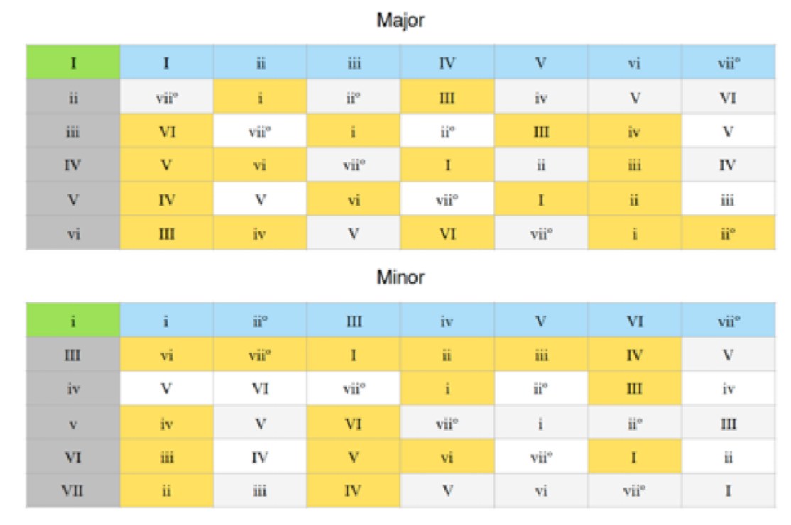
Pivot Chord Charts
These tables allow you to easily find pivot chords to modulate from one key to another closely related key, in both major and minor. The row on top is the starting key. The column on the left is the target key, that you want to modulate to. The yellow blocks show you the chords that are shared between the main key, and the target key. In order to find a pivot chord, choose a target key, and then find a yellow block. You can use that chord to modulate to the new key.
How To Use Them
1. Establish the first key. The tonic for the key you establish is now the green I or i in the top left corner of the table. Example: I = C major
2. Now decide the closely related key that you want to modulate to. Find that key’s roman numeral on the left hand column. Those roman numerals are in dark grey. I want to modulate to ii = D minor
3. Move along the row to see which chords are shared between the two closely related keys. The chords that are shared between C major and D minor are the ii chord (i chord in D minor) and the IV chord (III in D minor). They are highlighted in yellow.
4. Use one of those chords as a pivot, followed by the dominant of the new key.

Slide 24
Exercise
1.By using the given examples in C major, write out modulations from G major to all related keys
From G major to e minor
From G major to D major
From G major to b minor
From G major to C major
From G major to a minor
2. Play them on the keyboard using appropriate voicing and related chord inversions.

